Slide 1
ML Project for Regression
Yiqing Hu 455858
Raffaele Ricci K-15305

Slide 2

Data Checking
Correlation
Distribution
NA

Slide 3
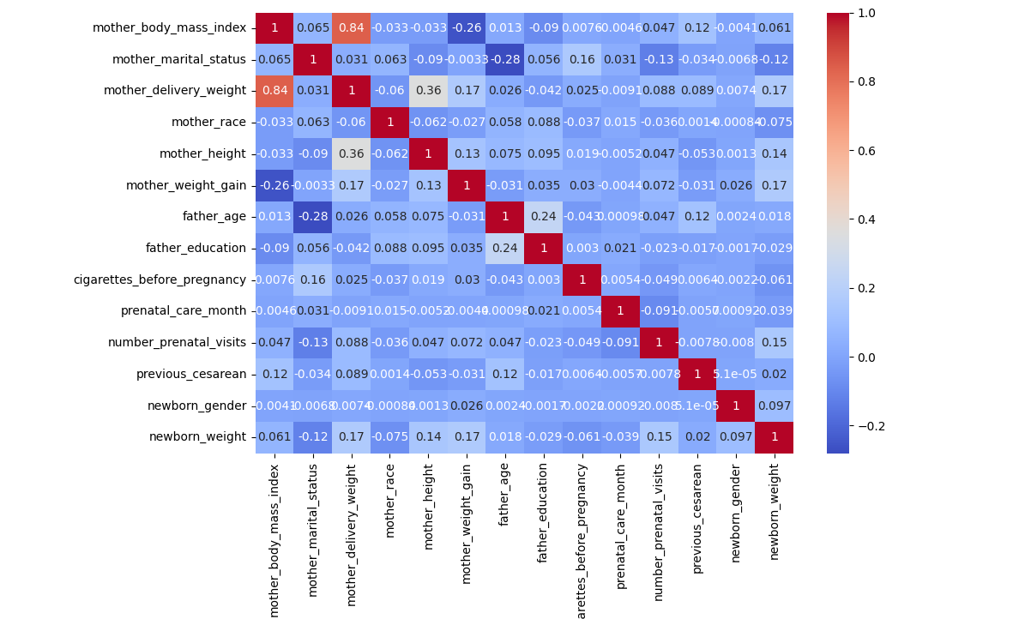

Slide 4
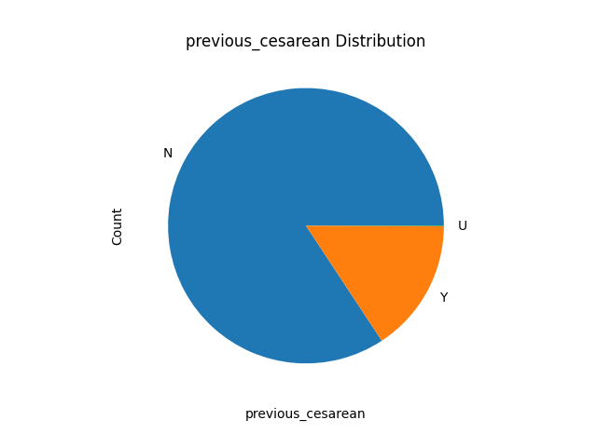
Visualization
Distribution of Discrete Data

Slide 5
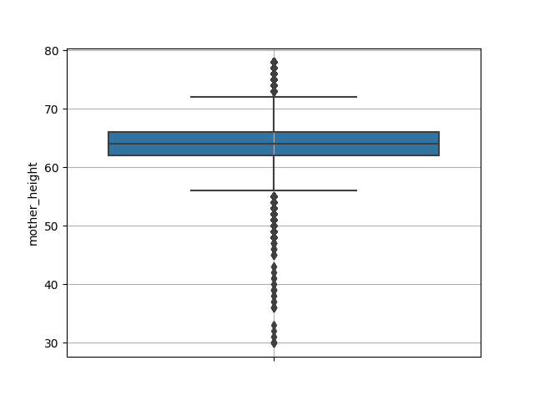
Visualization
Distribution of Float Data

Slide 6
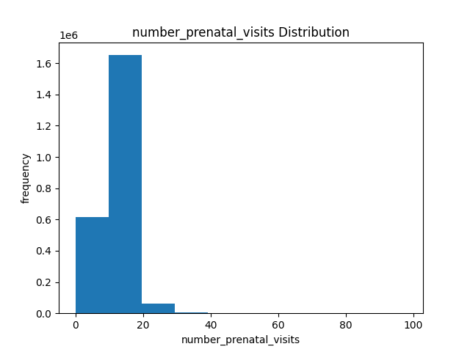
Visualization
Distribution of Int Data

Slide 7
NA Checking
col_name | col_type | NA_ratio
father_age | float64 | 18.53563
mother_marital_status | float64 | 17.20142
mother_height | float64 | 10.19671
mother_body_mass_index | float64 | 6.11313
mother_weight_gain | float64 | 3.06378
number_prenatal_visits | float64 | 2.49784
mother_delivery_weight | float64 | 1.45773
cigarettes_before_pregnancy | float64 | 0.47124
mother_race | int64 | 0.0
father_education | int64 | 0.0
prenatal_care_month | int64 | 0.0
previous_cesarean | object | 0.0
newborn_gender | object | 0.0
newborn_weight | int64 | 0.0

Slide 8

Feature Engineering
int/float/discrete
Fill NA/outlier with median/mean to int and float features
Make a new feature for old with which row has NA
Truncate outliers
Standardization and normalization for int and float features
Make discrete features as dummies
Power features which have high correlation with newborn weight

Slide 9
Algorithms
GLM/SVM/GBT
LM, Ridge, Lasso, ElasticNet, FM
SVR
LGBMRegressor

Slide 10
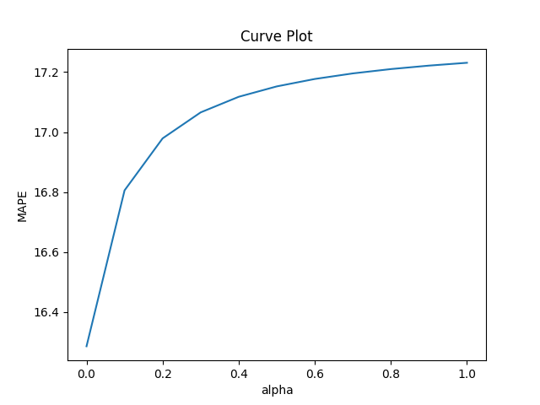
Tuning
For Lasso

Slide 11
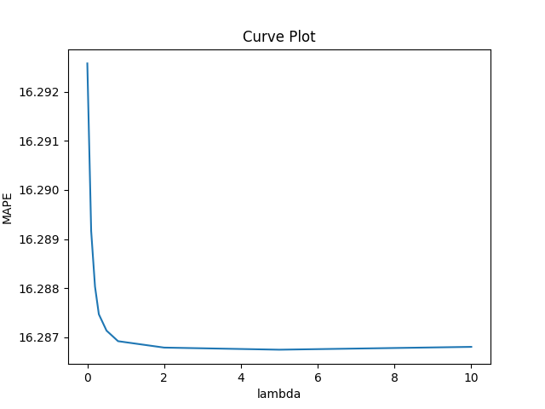
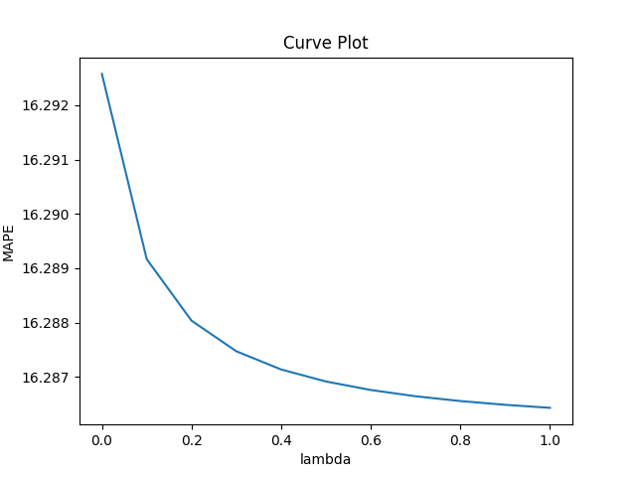
Tuning
For Ridge

Slide 12
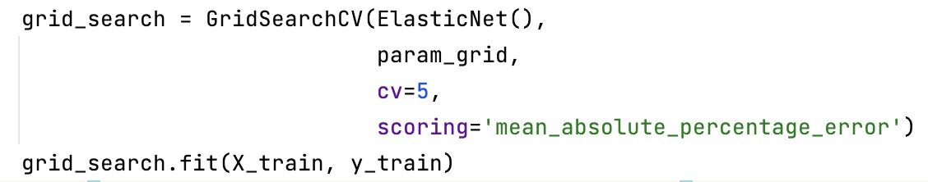
Tuning
For ElasticNet

Slide 13
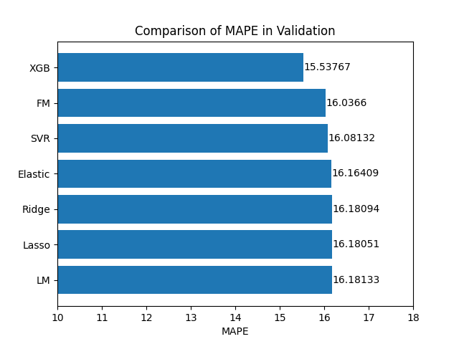

Slide 14
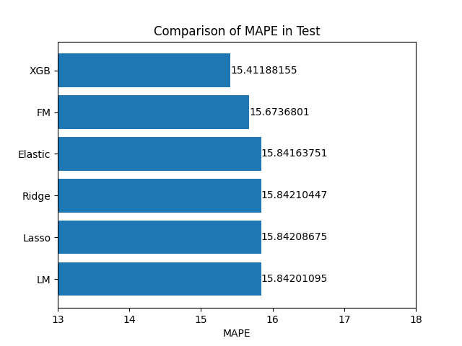

Slide 15
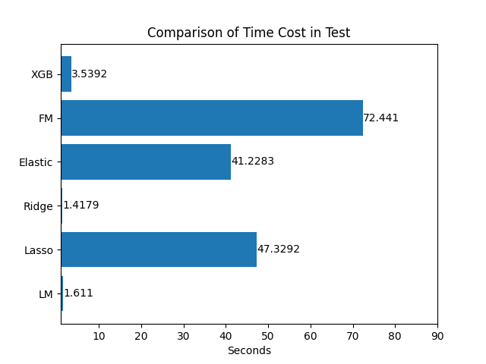

Slide 16
Result
LGT
Train time cost: within 3s for full train data
MAPE: 15.411% for 10% testset

Slide 17

Thanks
guys

